Slide 1


Leveraging R and AI in Clinical Research: Maximizing Analytical Efficacy While Ensuring Data Safety
Haomin Yang, Qianwang Wang, Xuejie Zhou, Hao Chen
Global Statistics and Data Science,
BeOne Medicines
2026.03
Notes:
Reference boxes on notes pages follow the same order as those on slides, though these references will be longer. This box should be bottom aligned with the page with a .1 boarder at the bottom.

Slide 2
Disclaimer
The content, ideas and conclusions presented in this presentation are solely those of the authors and do not necessarily represent or reflect the views, policies, or official positions of BeOne Medicines. While every effort has been made to ensure the accuracy and reliability of the information provided, BeOne Medicines does not endorse or assume responsibility for any statements, interpretations or recommendations made herein. The material is intended for informational purposes only and should not be construed as official opinion or guidance of BeOne Medicines.

Slide 3
Contents
01
Challenges of balancing data Security and AI Intelligence
02
Architecture
03
Future Outlook
04
Q & A

Slide 4
Challenges of balancing data Security and AI Intelligence

Slide 5


Today ——AI capabilities have improved across the board
AI can write R code, analyze clinical data, and generate insights in seconds.
Non-programmers — medical monitors, safety scientists — can query data through natural language.
For example, Claude Code from Anthropic was always a helpful coding assistant, but in November 2025, it suddenly got much better. (Photo: Bloomberg)
Notes:
我们正处在一个转折点。大语言模型现在不仅能在几秒钟内编写R代码、分析临床数据、生成洞察——而且不只是简单的汇总。它能处理生存分析、GEE模型、复杂的交叉列表，甚至能自我修正的多步骤分析工作流。质量和速度都令人印象深刻。
想一想这对我们的日常工作意味着什么：一个统计师花几个小时写和调试的分析代码，AI几秒钟就能给出初稿。一个以前需要一天才能回答的临时安全性查询，现在一分钟就能完成。以往需要程序员出表格，业务部门审查的这种合作模式，现在非程序员也能够通过自然语言来query数据

Slide 6
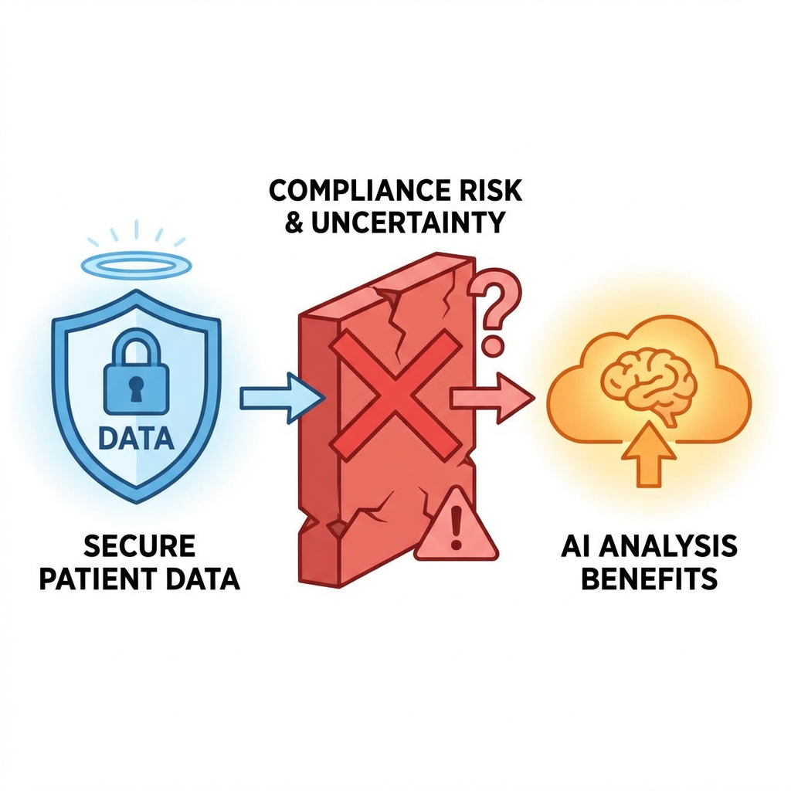
Problem —— We can't simply use it
Privacy & compliance: Sending identifiable clinical data to AI can violate HIPAA and increase re-identification risk, especially with external or cloud AI.(AI and data protection)
GxP & regulation: Regulators expect AI that affects submissions or GxP records to be validated and governed; direct analysis puts AI on the critical path and increases accountability. (Guidance on Gxp )
Data integrity: Use AI only on metadata/code generation and run the actual analysis in a controlled, auditable environment so ALCOA+ and governance stay clear.
Notes:
为什么不能直接用 AI 分析敏感临床数据 — 三点
隐私与合规 把可识别临床数据（PHI）交给 AI，尤其是外部/云端 AI，可能构成 HIPAA 下的「使用/披露」，需授权且满足「最小必要」。脱敏数据也不安全：AI 可通过关联攻击或推断实现再识别（文献指出少量标识符即可重识别大量个体）。
数据一旦进入商用/通用 AI，还会脱离临床/研究等受控场景，落入监管薄弱地带。因此，直接喂敏感临床数据给 AI 会带来披露、再识别和合规风险。
GxP 与监管预期 监管明确：AI 不减免 GxP 义务。若 AI 直接参与分析并产出会进入申报、TMF 或检查记录的结果，则该 AI 使用需纳入 QMS、按风险验证并保持可追溯。直接分析等于把 AI 放在关键路径上，验证和问责负担高；
只让 AI 接触元数据/生成代码、由人在受控环境中执行分析，则风险可控、监管预期更易满足。
数据完整性与治理 敏感临床数据受 ALCOA+ 和全生命周期治理约束。若由 AI 直接处理这些数据，输入/输出、版本、访问与审计链难以完全满足 GxP 与 21 CFR Part 11 的预期；
且「最小必要」和用途限定（临床 vs 研究）在数据流入 AI 后更难界定。让 AI 只接触非识别性元数据或匿名化片段，真实分析在已受控、可审计的系统内由人执行，更利于满足数据完整性与治理要求。
在制药行业，临床试验数据是最敏感的数据之一。它包含患者级别的信息——个体的不良事件、实验室检查结果、病史、人口统计学细节。在大多数公司的数据分类体系中，这属于**第四级敏感性数据**。
我们受到层层法规约束：ICH E6(R2)和GCP要求严格的数据处理规范。GDPR和HIPAA对个人健康信息有法律强制要求。21 CFR Part 11要求审计追踪和访问控制。公司SOP在此之上还有更多限制。
一旦你把患者级别的数据发送到外部AI服务——哪怕是托管在你自己云租户上的——就会面临严肃的合规问题。谁能访问这些数据？它会被存储吗？会不会被用于模型训练？你能保证它没有被记录在某个日志里吗？一些公司的数据治理政策明确禁止**任何**患者级别的临床数据被语言模型处理，没有例外。
而且这不是理论上的担忧。我接触过的每一家公司都面临同样的困境——AI能力就在那里，业务价值也很明显——但没有人完全解决了如何安全地将AI用于真实临床数据的问题。

Slide 7
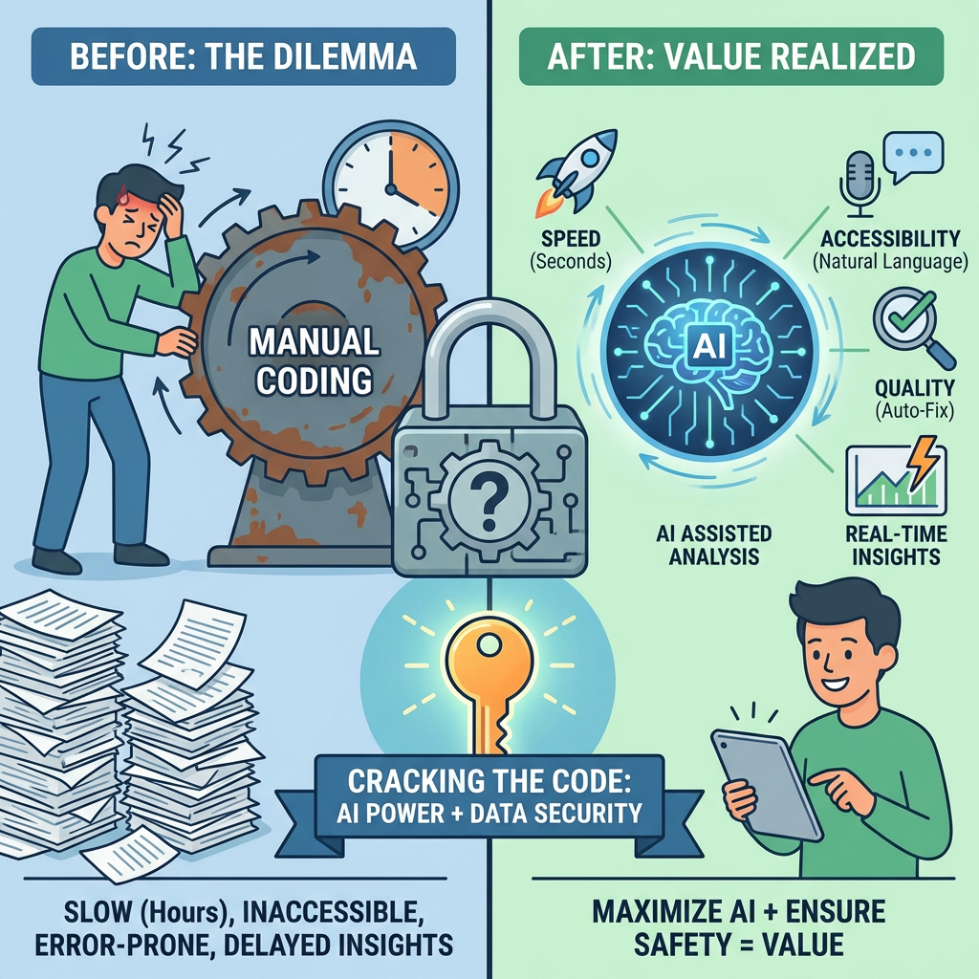
Value —— If we can combine AI and safety data
If we can find a way to harness AI's analytical power while keeping patient data genuinely safe.
**Speed**: from hours of manual coding to seconds of AI-assisted analysis
**Accessibility**: None-programmers can interact with data through natural language
**Quality**: AI can catch errors, suggest better approaches, Stably output runnable programs
**Real-time insight**: exploratory analysis during live meetings, not days later

Slide 8
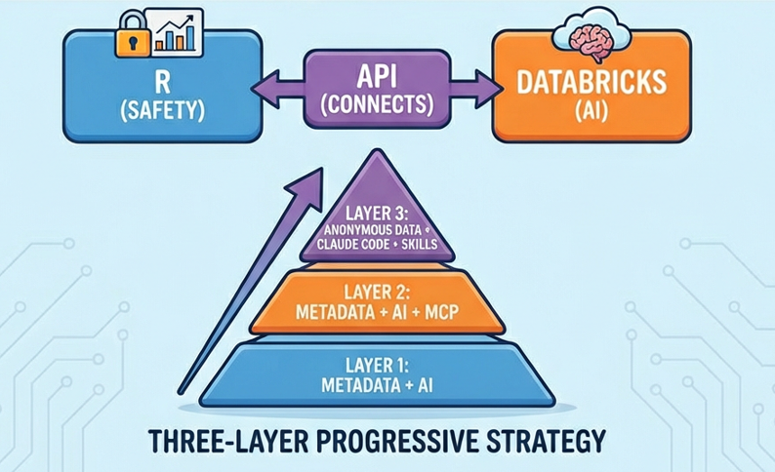
Our mission —— Maximize AI Capability While Ensuring Data Safety
AI capability VS clinical data safety, every company faces this exact dilemma.
Our approaches:
R handles safety • Databricks handles AI • API connects them
A three-layer progressive strategy that scales AI involvement while systematically minimizing data exposure.

Slide 9
Architecture

Slide 10
R Handles Safety, AI Handles Intelligence
R / R Shiny
Python / Databricks
Safety & Real Data Layer
AI & Agent Layer
Dual-track context management
Dual-track data management
Session code execution
Permission control & access
Real Data loading
Isolated session state
Table & chart rendering
Desensitized context
Anonymous data
Sandboxed code execution
Model serving endpoints
MCP client deploy
Claude Code SDK integration
AI agent orchestration
Audit Trial and token usage
AI components
Input and output management
*This separation is a security boundary — AI components physically cannot access Real data and context

Slide 11




R Handles Safety, AI Handles Intelligence
R / R Shiny
Python / Databricks
Safety & Real Data Layer
AI & Agent Layer
Isolated R session
AI components
Rawdata
metadata
anonymize data
Desensitized context
Session code executor
Sandbox
Code generate
Code execute and self-debug
Review output
download data and TFLs
edit code and re-execute
Table and Figure render

Slide 12
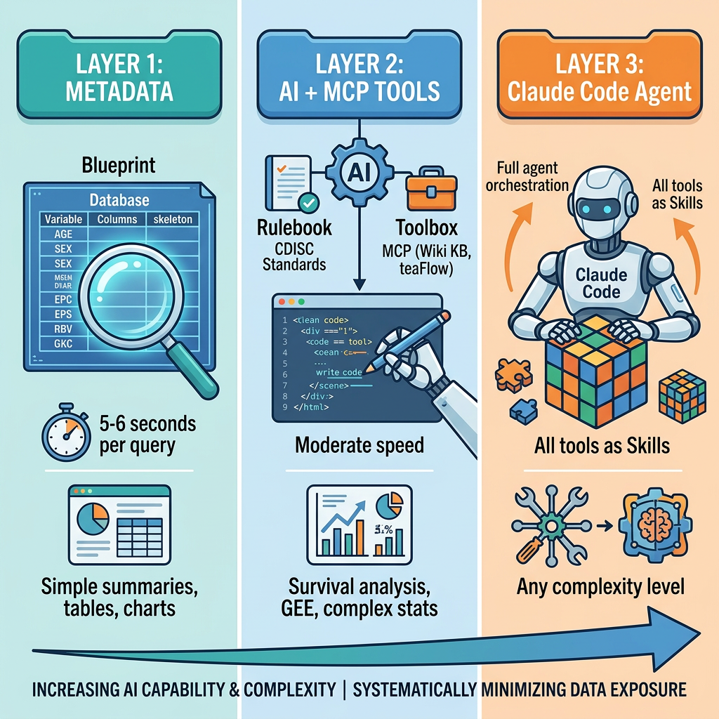
The Three-Layer Strategy
From simple API calls to full agent orchestration. Each layer is a stage in our journey.
LAYER 1 (Metadata + AI)
Dual-track architecture
5-10 seconds per query
LAYER 2 (Metadata + AI + MCP)
CDISC Standards MCP tool
DeepWiki Knowledge tool
Tealflow MCP tool
LAYER 3 (Claude Code SDK)
Anonymized + truncated data
Skills
1-2 mins per query

Slide 13
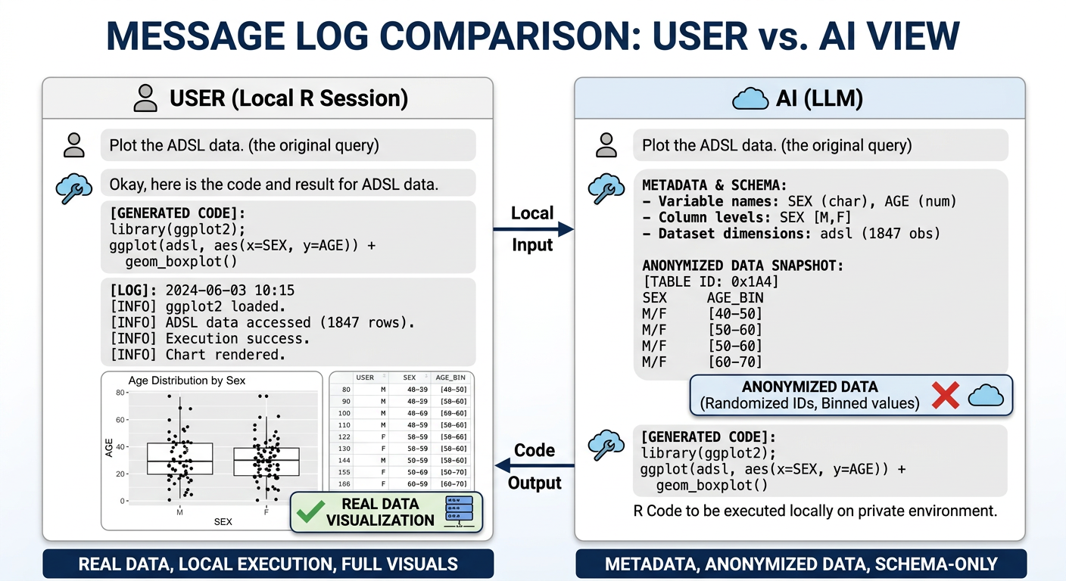
R details —— Dual-Track context
The message record is composed of:
Data (User Only)
Metadata for Data
User Query
Code
Code Execution Log(User Only)
Code Execution Results(User Only)
AI Interpretation(User Only)

Slide 14
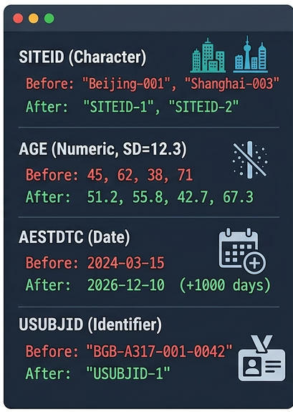
R details —— Anonymization
Anonymization is performed independently for each dataset:
Different anonymization rules are used for
numeric, character and date changes
Specify anonymity for specific variables
(e.g. SUBJID/SITE)
After AI gets metadata and variable labels, determines which variables to anonymize.

Slide 15
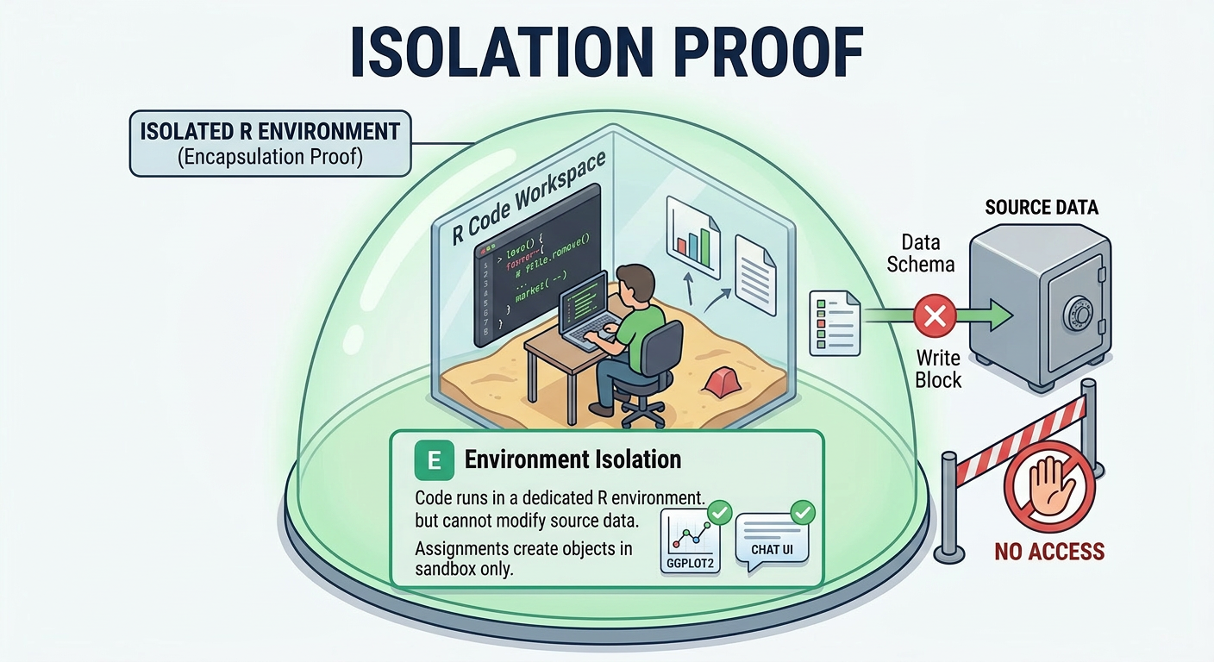
R details —— Session setup
Isolation: Code execution does not affect external environments or real data.
Security: Enforcing a function whitelist and blocking high-risk operations.
Control: Captures all outputs, enabling users to debug and edit code.
Resource Protection: enforcing a timeout mechanism.
Notes:
1. Environment Isolation（环境隔离）
作用：提供一个独立的 R 环境运行代码。
特点：
可以读取数据集，但无法修改源数据，保护数据完整性。
所有对象的创建和操作都限制在一个“沙盒”环境中，避免对外部环境的影响。
2. Function Whitelisting（函数白名单）
作用：限制允许使用的函数，确保代码安全。
特点：
允许的函数：如 dplyr、tidyr 和 ggplot2 的常见函数（filter()、mutate()、ggplot()、summarise()等）。
禁止的函数：可能对系统或外部环境有风险的函数被禁用（如 system()、file.remove()、source()、install.packages() 等）。
3. Output Capture（输出捕获）
作用：捕获所有代码执行的输出。
特点：
捕获控制台的文本、警告、错误信息和图表。
用户可以通过捕获的输出，与 AI 进行交互，解决错误或改进代码。
4. Timeout Protection（超时保护）
作用：防止代码运行时间过长或资源耗尽。
特点：
每次代码执行设置了时间限制。
如果代码进入无限循环或超时，会自动终止执行，保护系统资源。

Slide 16
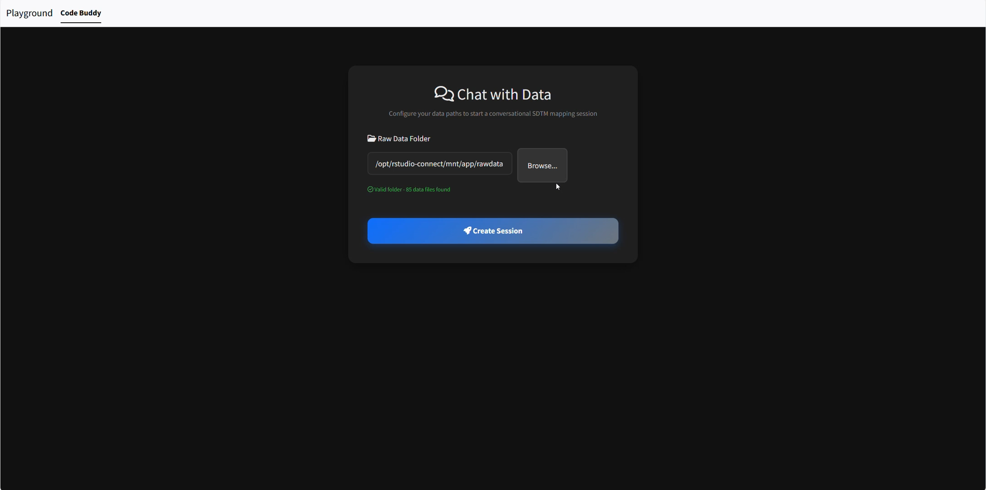
R shiny demo

Slide 17
Why Databricks?
1
Already Approved Platform
Databricks vs. Consumer AI
Many pharma companies have already validated Databricks. No new platform approval needed.
Databricks: Data stays in your cloud tenant
2
Enterprise-Grade Security
Consumer AI: Data sent to third-party servers
Network isolation, encryption at rest and in transit, role-based access control.
Databricks: Full audit trail
3
Audit Logging
Consumer AI: Limited visibility
Every API call, every agent action is logged. Full traceability for regulatory inspection.
Databricks: SOC 2 / HIPAA compliant
4
Company Workspace
Consumer AI: Varies by provider
Agent runs within your own Databricks workspace — not a third-party consumer AI service.

Slide 18
MCP Tools
MCP Benefits
MCP Technical Stack
Protocol: JSON-RPC 2.0
Eliminates N×M Integration
Single protocol replaces custom connectors for each LLM-tool pair
Pattern: Client-Host-Server
Standardized Context Exchange
Transport: Stdio / HTTP+SSE
JSON-RPC based communication with persistent stateful sessions
State: Persistent Sessions
Regulatory Compliance
Ensures FDA/PMDA submission-ready data structures
Modular Architecture
Tools, models, and data layers can be updated independently

Slide 19
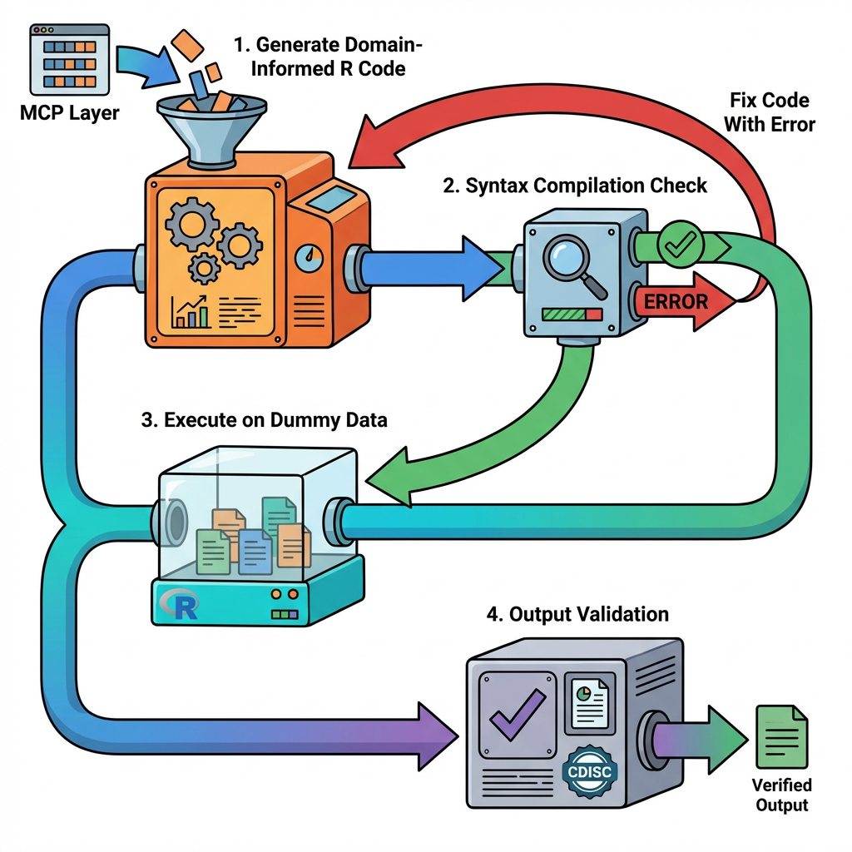
Databricks Agent
1
Generate Domain-Informed R Code
Ingest CDISC-compliant code from MCP integration layer with full metadata context
Syntax Compilation Check
2
Validate R syntax, package dependencies, and function calls in isolated environment
3
Execute on Dummy Data
Run code in sandbox with synthetic data matching SDTM/ADaM structure
4
Output Validation
Verify data transformations, statistical calculations, and CDISC compliance

Slide 20
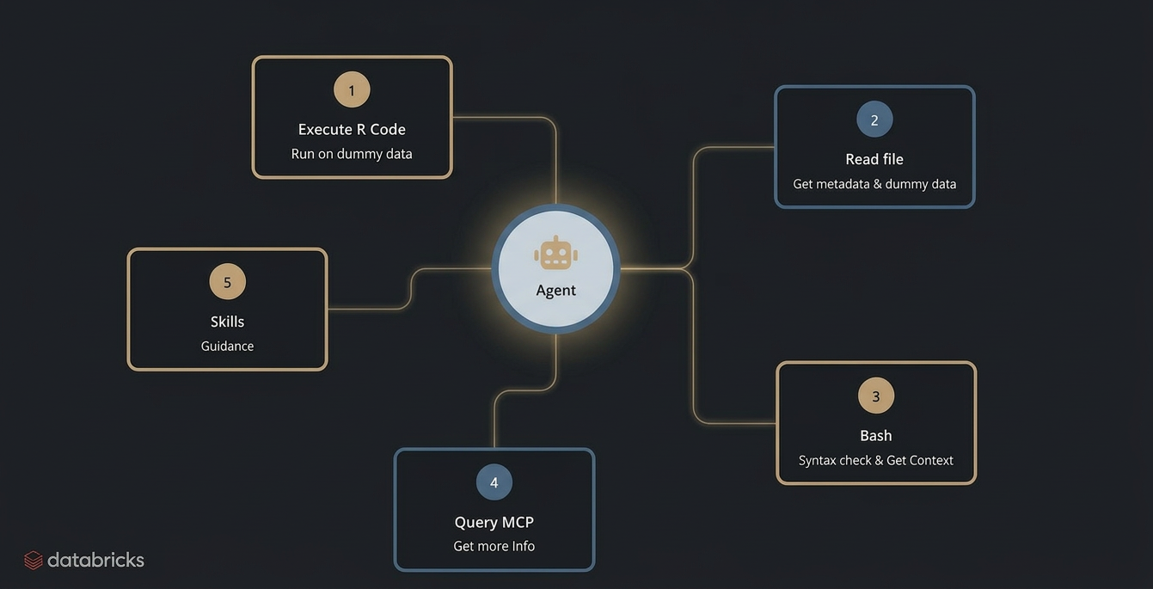

Databricks Agent - Architecture

Slide 21
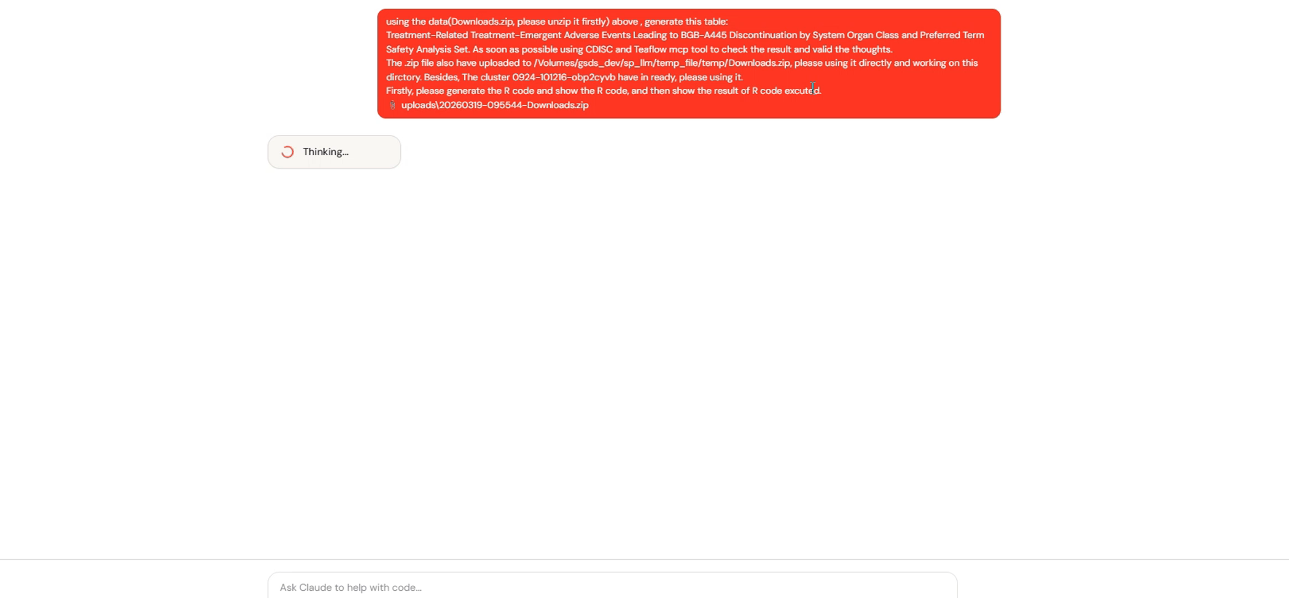
Databricks demo

Slide 22
Future Outlook

Slide 23
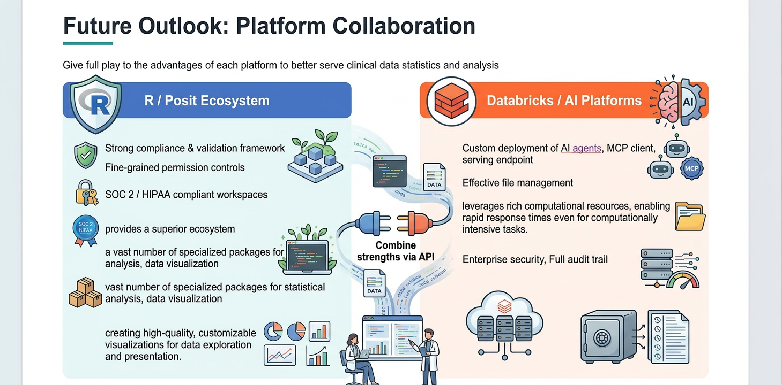
Trusted, compliance-focused analytics platform with a deep ecosystem for statistical analysis and data visualization
High-performance AI and data platform for advanced analytics, scalable computing, and rapid innovation
Notes:
本质上这俩就是矛盾的 要合规就要保守 要接入AI就要加速创新和变革 所以很难一个平台兼顾 我们合二为一
Traditional platforms like R ensure stability,
Databricks or cloud providers (AWS, Azure, GCP) drive rapid transformation.
Combining the best of both is the key to success.

Slide 24
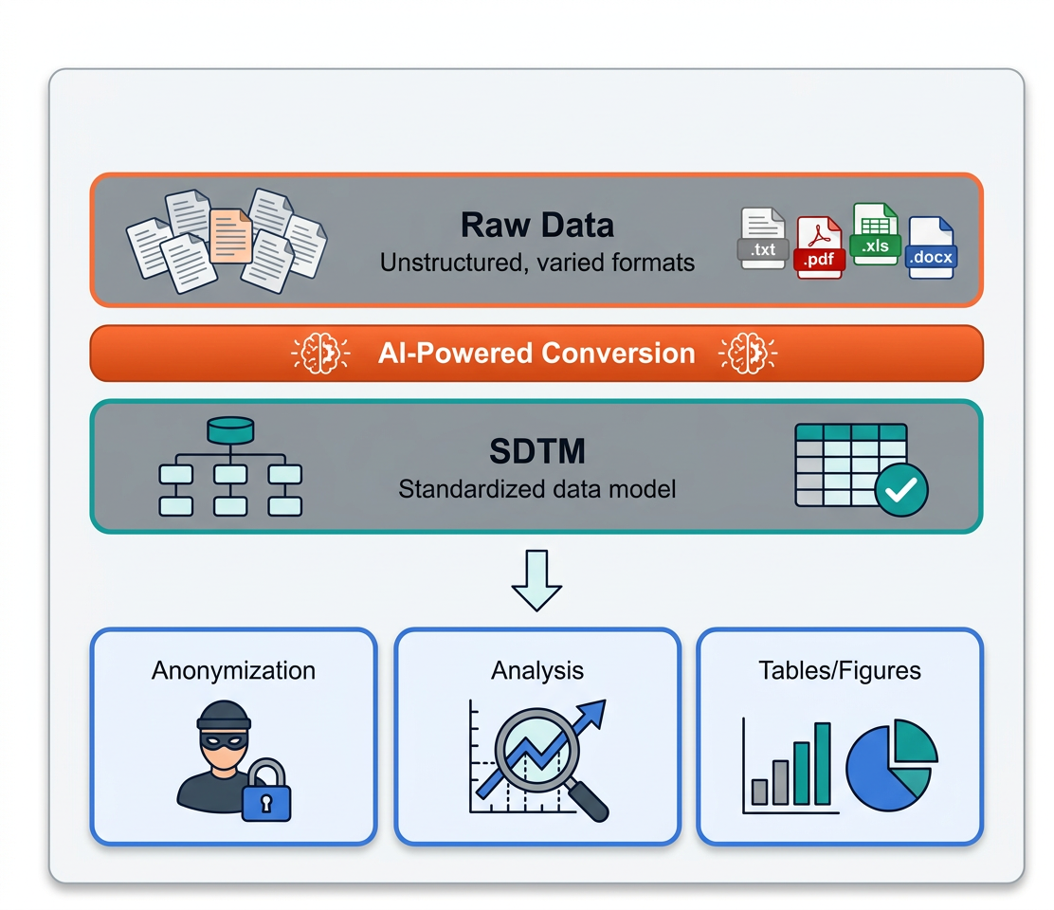
Future Opportunity —— SDTM auto transformation
Single Source of Truth
Accelerated Downstream Workflows
Easier Anonymization
Standardized Analysis
Efficient Tables & Figures
Earlier, Better Decisions
Notes:
Virtual data generation could fully resolve data privacy.
从R发送匿名化数据这一步骤，其实可以再进一步，提前再R和databricks中部署好特定的镜像环境，而不是每次分析时的临时同步。

Slide 25
Acknowledgment
Xiang Guo
Cindy Song
You Li
Tao Zhang
Jinling Li
Shuang Gao
Xiaoyuan Huang
Wei Wang
Jing Wang
Chunpeng Zhao
Raymond Chan
Yaohui Zhu

Slide 26
Q & A

